Slide 1
Lecture 18

Slide 2
Message Authentication Code

Slide 3
Message authentication code (MAC)
generated by an algorithm that creates a small fixed-sized block
depending on both message and some key
like encryption though need not be reversible
MAC_{M} = F(K_{AB}, M)
appended to message as a signature
receiver performs same computation on message and checks it matches the MAC
provides assurance that message is unaltered and comes from sender

Slide 4
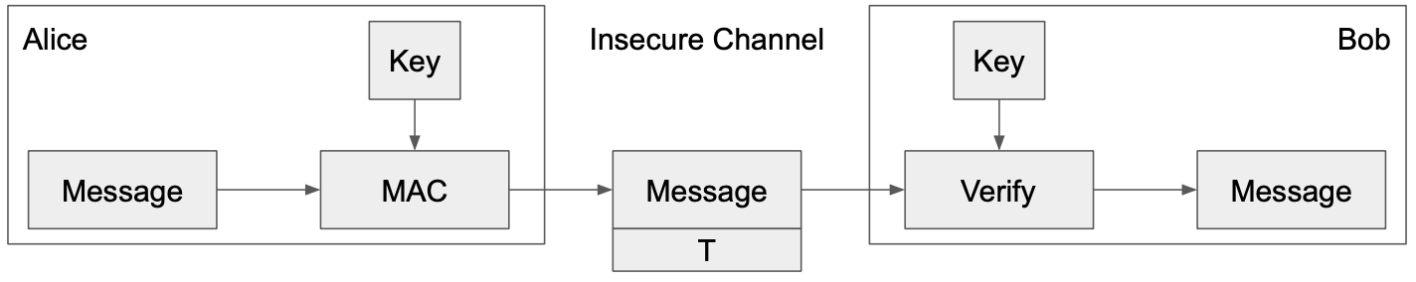
MACs: Usage
Alice wants to send M to Bob, but doesn’t want David to tamper with it
Alice sends M and T = MAC(K, M) to Bob
Bob receives M and T
Bob computes MAC(K, M) and checks that it matches T
If the MACs match, Bob is confident the message has not been tampered with (integrity)

Slide 5
MACs: Definition
Two parts:
KeyGen() → K: Generate a key K
MAC(K, M) → T: Generate a tag T for the message M using key K
Inputs: A secret key and an arbitrary-length message
Output: A fixed-length tag on the message
Properties
Correctness: Determinism
Note: Some more complicated MAC schemes have an additional Verify(K, M, T) function that don’t require determinism, but this is out of scope
Efficiency: Computing a MAC should be efficient
Security: existentially unforgeable under chosen plaintext attack

Slide 6
Existentially unforgeable
A secure MAC is existentially unforgeable: without the key, an attacker cannot create a valid tag on a message
David cannot generate MAC(K, M') without K
David cannot find any M' ≠ M such that MAC(K, M') = MAC(K, M)

Slide 7
Example: HMAC
issued as RFC 2104 [1]
has been chosen as the mandatory-to-implement MAC for IP Security
Used in Transport Layer Security (TLS) and Secure Electronic Transaction (SET)
[1] “HMAC: Keyed-Hashing for Message Authentication”, RFC 2104, https://datatracker.ietf.org/doc/html/rfc2104

Slide 8
HMAC(K, M)
will produce two keys to increase security
If key is longer than the desired size, we can hash it first, but be careful with using keys that are too much smaller, they have to have enough randomness in them
Output H[(K⁺ ⊕ opad) || H[(K⁺ ⊕ ipad) || M]]

Slide 9
Example: HMAC
HMAC(K, M):
Output H[(K⁺ ⊕ opad) || H[(K⁺ ⊕ ipad) || M]]
Use K to derive two different keys
opad (outer pad) is the hard-coded byte 0x5c repeated until it’s the same length as K⁺
ipad (inner pad) is the hard-coded byte 0x36 repeated until it’s the same length as K⁺
As long as opad and ipad are different, you’ll get two different keys
For paranoia, the designers chose two very different bit patterns, even though they theoretically need only differ in one bit

Slide 10
HMAC procedure
Step 1: Append zeros to the left end of K to create a b-bit string K⁺ (e.g., if K is of length 160 bits and b = 512, then K will be appended with 44 zero bytes);
Step 2: XOR (bitwise exclusive-OR) K⁺ with ipad to produce the b-bit block S_{i};
Step 3: Append M to S_{i};
Step 4: Apply H to the stream generated in step 3;
Step 5: XOR K⁺ with opad to produce the b-bit block S_{o};
Step 6: Append the hash result from step 4 to S_{o};
Step 7: Apply H to the stream generated in step 6 and output the result.

Slide 11
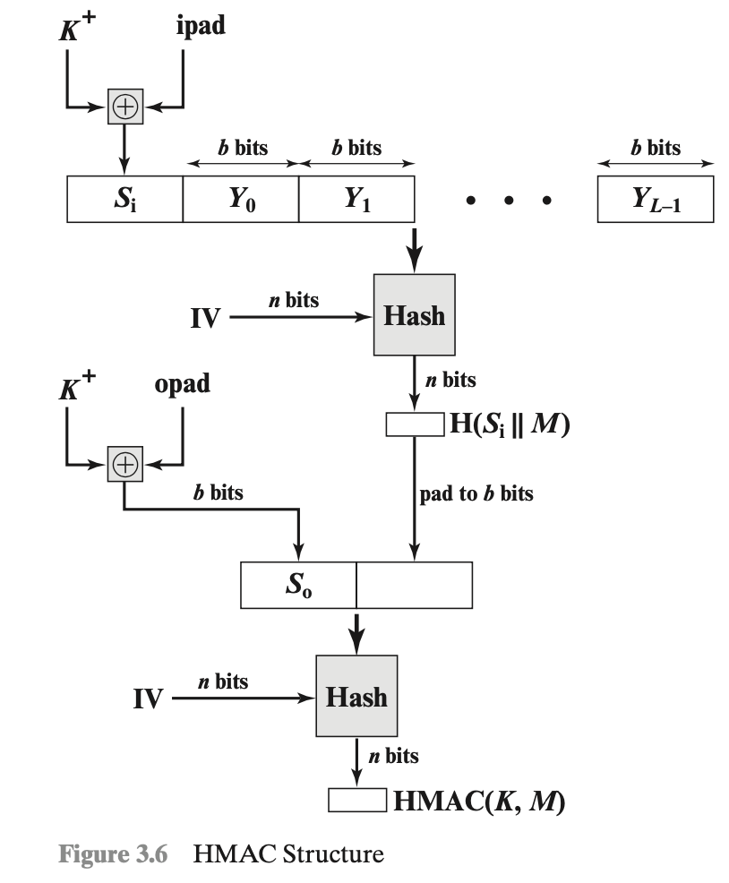
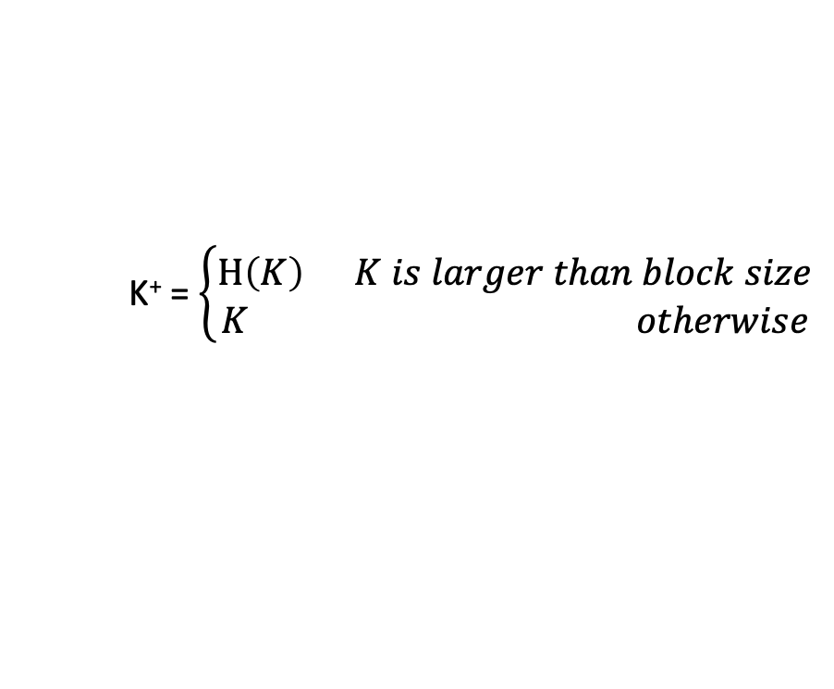
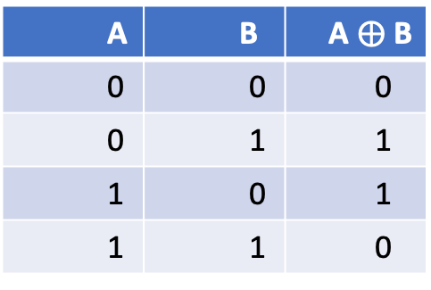
HMAC
A | B | A $⨁$ B
0 | 0 | 0
0 | 1 | 1
1 | 0 | 1
1 | 1 | 0
K⁺ = $\left\{\begin{aligned}H\left(K\right) K is larger than block size \\ K otherwise\end{aligned}\right.$
ipad = 00110110 , repeat b/8 times
opad = 01011100, repeat b/8 times

Slide 12
HMAC Properties
HMAC(K, M) = H[(K⁺ ⊕ opad) || H((K⁺ ⊕ ipad) || M]]
HMAC is a hash function, so it has the properties of the underlying hash too
It is collision resistant
Given HMAC(K, M) and K, an attacker can’t learn M – one way
If the underlying hash is secure, HMAC doesn’t reveal M, but it is still deterministic
You can’t verify a tag T if you don’t have K
This means that an attacker can’t brute-force the message M without knowing K

Slide 13
Do MACs provide integrity?
Do MACs provide integrity?
Yes. An attacker cannot tamper with the message without being detected
Do MACs provide authenticity?
It depends on your threat model
If only two people have the secret key, MACs provide authenticity: it has a valid MAC, and it’s not from me, so it must be from the other person
If a message has a valid MAC, you can be sure it came from someone with the secret key, but you can’t narrow it down to one person
Do MACs provide confidentiality?

